Slide 1
Fire Incidents🔥🔥🔥
Jacob Rottmann

Slide 2

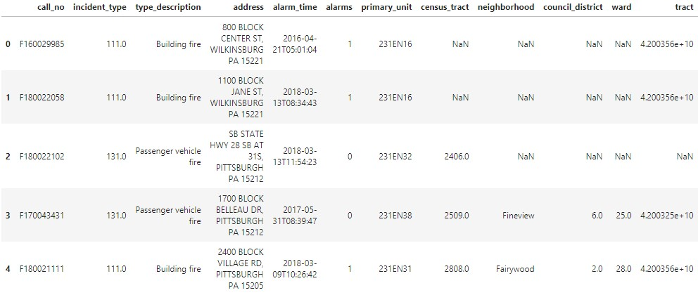
Do some setup stuff

Slide 3
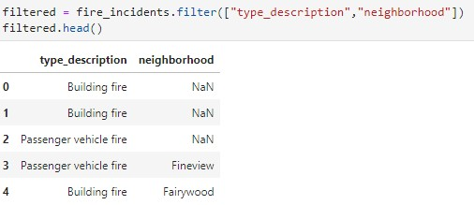
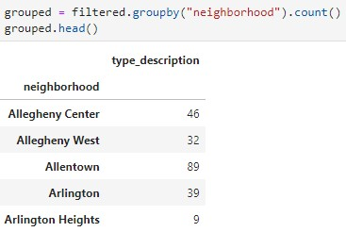
Make it better
Count the fires from each neighborhood,
making it even better

Slide 4
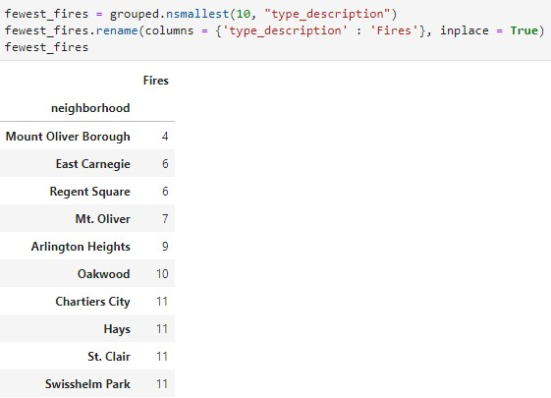
Show the ten neighborhoods with the least fires, and rename “type_description” to “Fires”

Slide 5
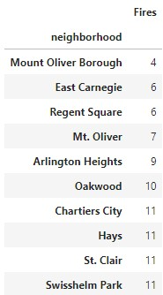
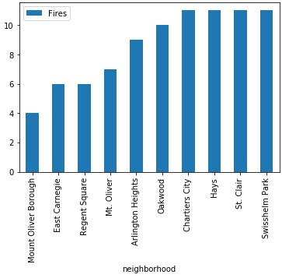
Conclusion
The fewest number of fires in the dataset occurred in Mount Oliver Borough.

